Slide 1
Publishing Scheme for Skewed Data Set
Team #34 Yichen Zhu, Zhenhao Cao

Slide 2
Outline
Description & Formulation
A Basic Idea
Optimization
Analysis
Experiment Result

Slide 3
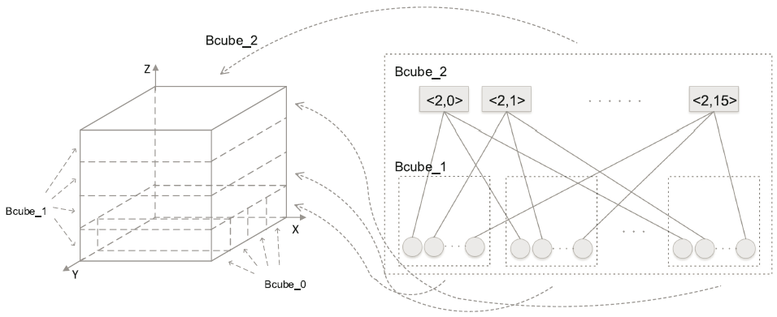
Description
Task: publish a data set to the indexing space

Slide 4
Existing Work
Direct-Publishing
Skewed Data Set → Hot Spot Problem
Hash Table
High space complexity
Low adaptability

Slide 5
Formulation
Formulation: To design a mapping scheme
Requirements
Work on skewed data set
High adaptability
Low space complexity

Slide 6
A Basic Idea
Sorting-Based Mapping
A data set with range [0,20]: 5 10 18 3 6 2 15 1
Sorting Number: #1 #2 #3 #4 #5 #6 #7 #8
Normalization: 1/8 2/8 3/8 4/8 5/8 6/8 7/8 8/8

Slide 7
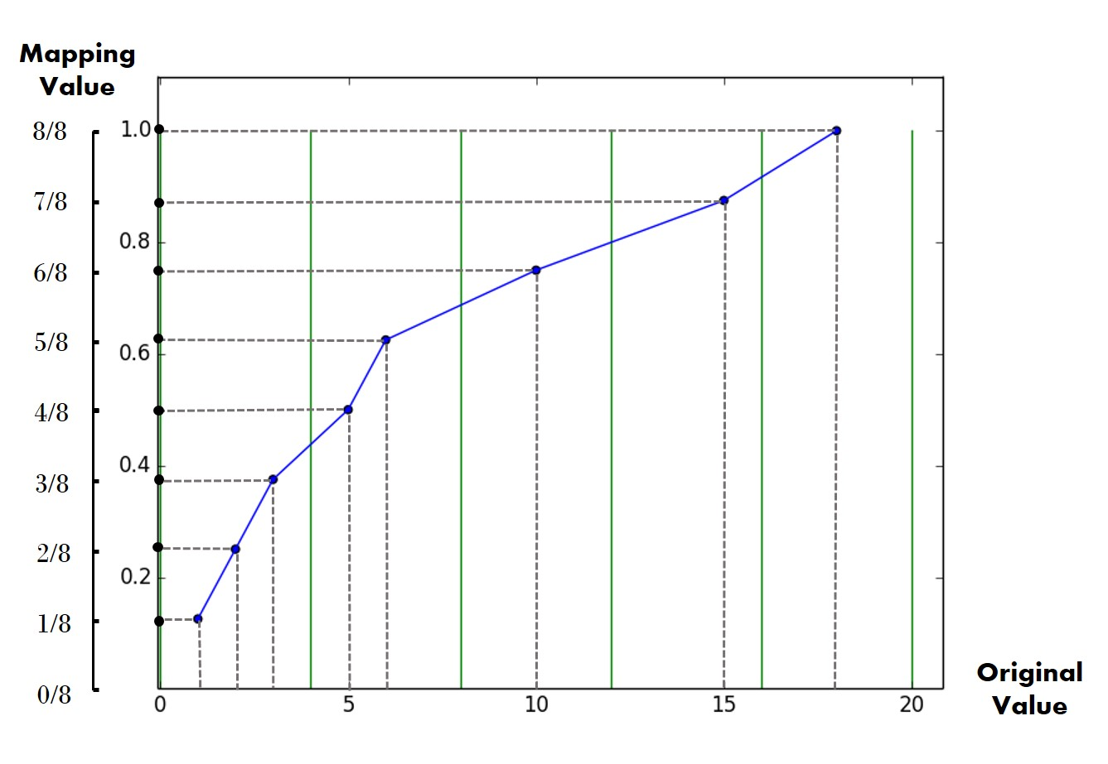

Slide 8
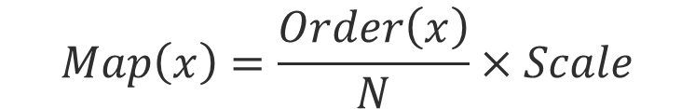
A Basic Idea
Sorting-Based Mapping
A data set sorted in ascending order: n₁, n₂, ……, n_{m}
Mapping Value of x
Drawback
Massive Data →
Sorting all the data points is expensive!
$$Map\left(x\right)=\frac{Order\left(x\right)}{N}×Scale$$

Slide 9
New Formulation
Formulation: To design a mapping scheme
Requirements
Work on skewed data set
High Adaptability
Low space complexity
Low time complexity

Slide 10
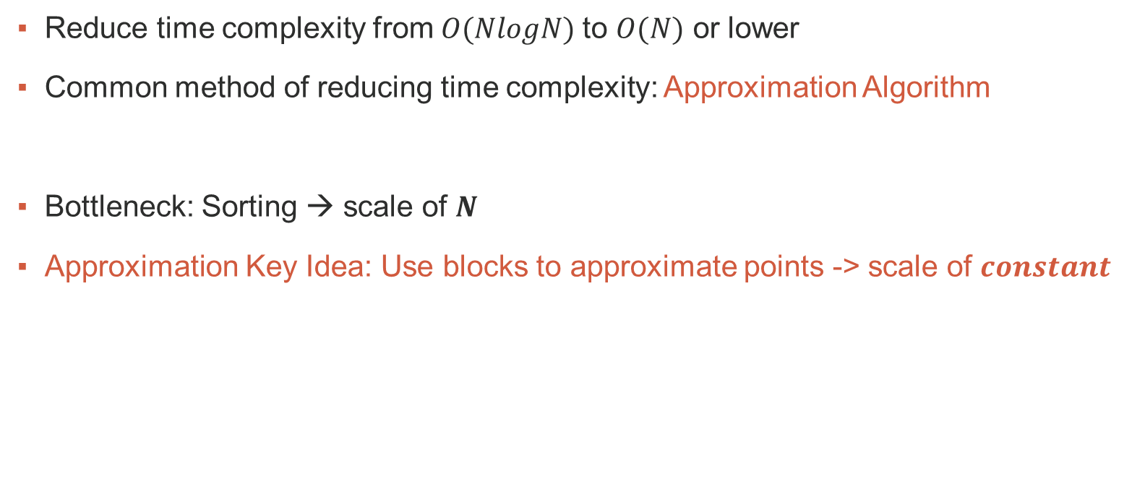
Inspiration
Reduce time complexity from $O(NlogN)$to $O(N)$ or lower
Common method of reducing time complexity: Approximation Algorithm
Bottleneck: Sorting → scale of $N$
Approximation Key Idea: Use blocks to approximate points -> scale of $constant$

Slide 11
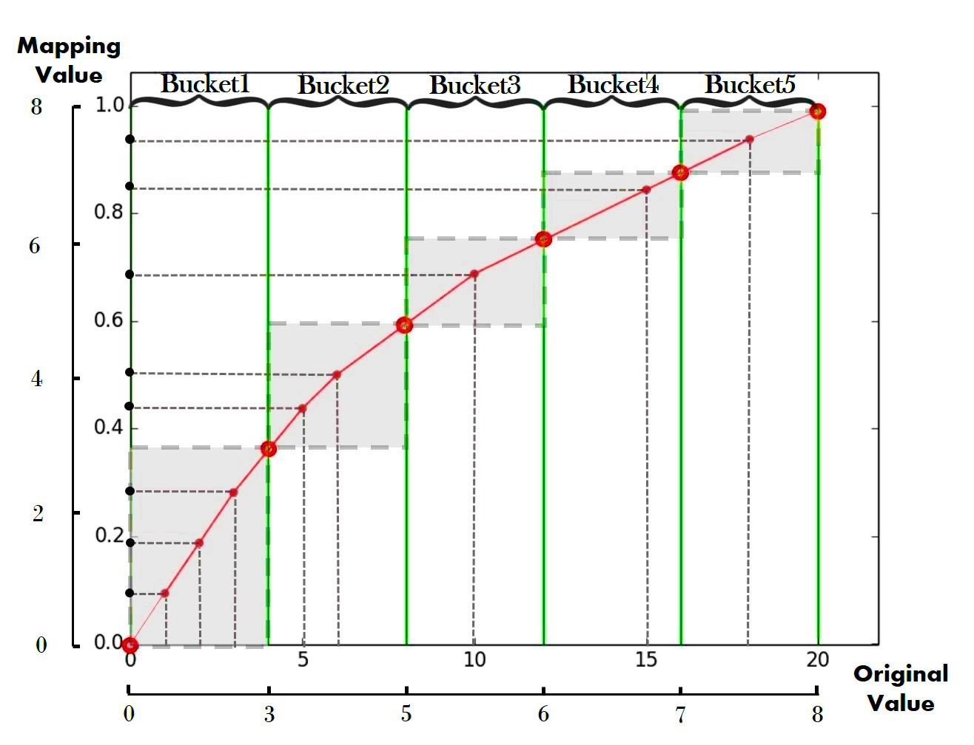
Optimization: Approximation Algorithm

Slide 12
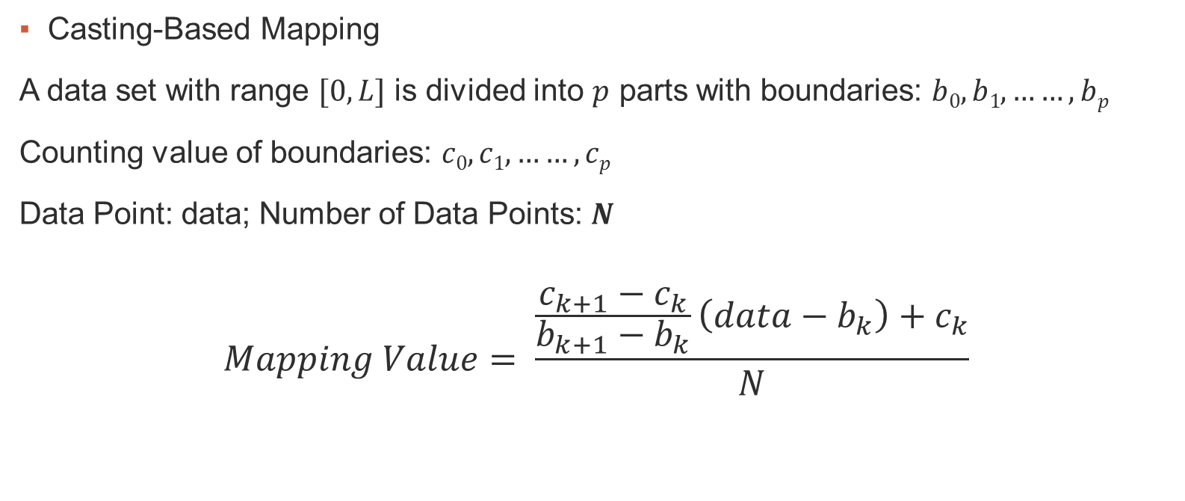
Optimization
Casting-Based Mapping
A data set with range $[0,L]$ is divided into $p$ parts with boundaries: $b0, b1, ……, bp$
Counting value of boundaries: $c0, c1, ……, cp$
Data Point: data; Number of Data Points: $N$
$$Mapping Value= \frac{\frac{c_{k+1}−c_{k}}{b_{k+1}−b_{k}}\left(data−b_{k}\right)+c_{k}}{N}$$

Slide 13
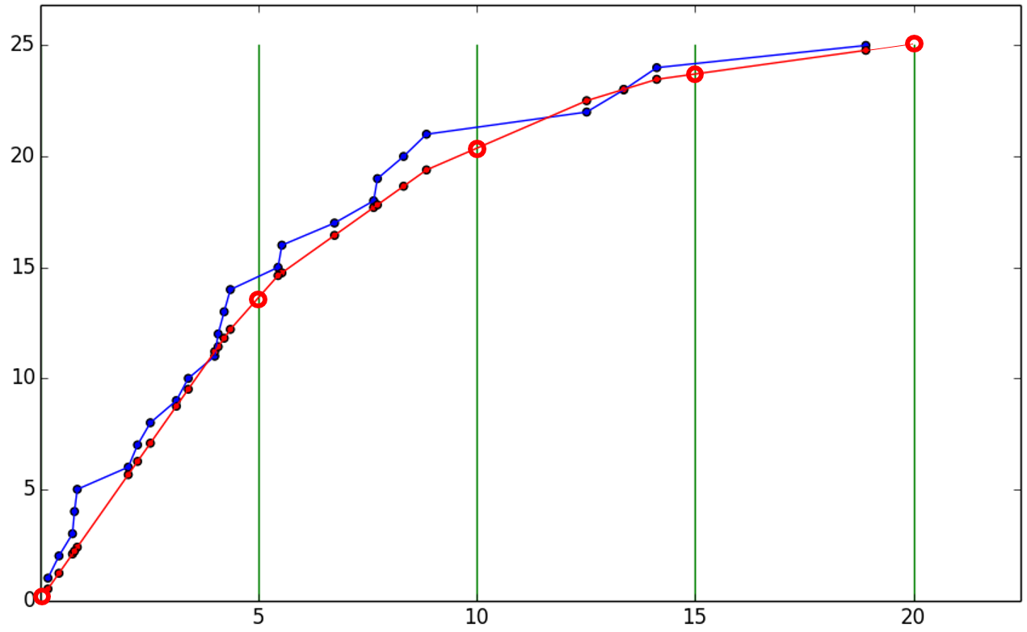
Comparison: sorting-based vs. casting-based
Approximation does something similar to fitting.
Note that the approximation algorithm used here can be seen as a regression of the original polyline (or curve in massive data sets).

Slide 14
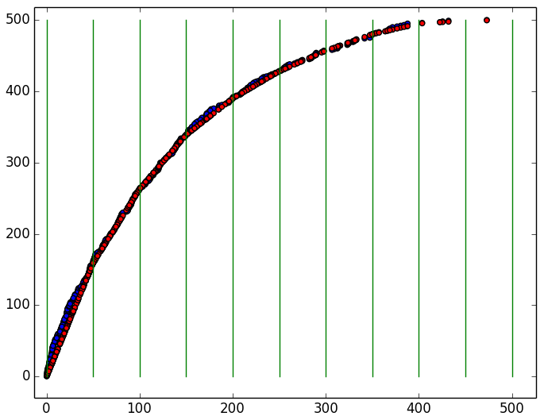
Comparison: sorting-based vs. casting-based
Approximation does something similar to fitting.
In massive data sets, polyline transforms into curve, and the approximation transforms into regression problem. Our method turns out to be a good regression.

Slide 15
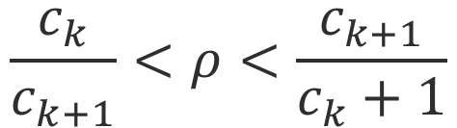
Theoretical Proof
Approximation Ratio
Define approximation ratio Rho = v(sorting-based) / v(casting-based)
$$\frac{c_{k}}{c_{k+1}}<ρ<\frac{c_{k+1}}{c_{k}+1}$$

Slide 16
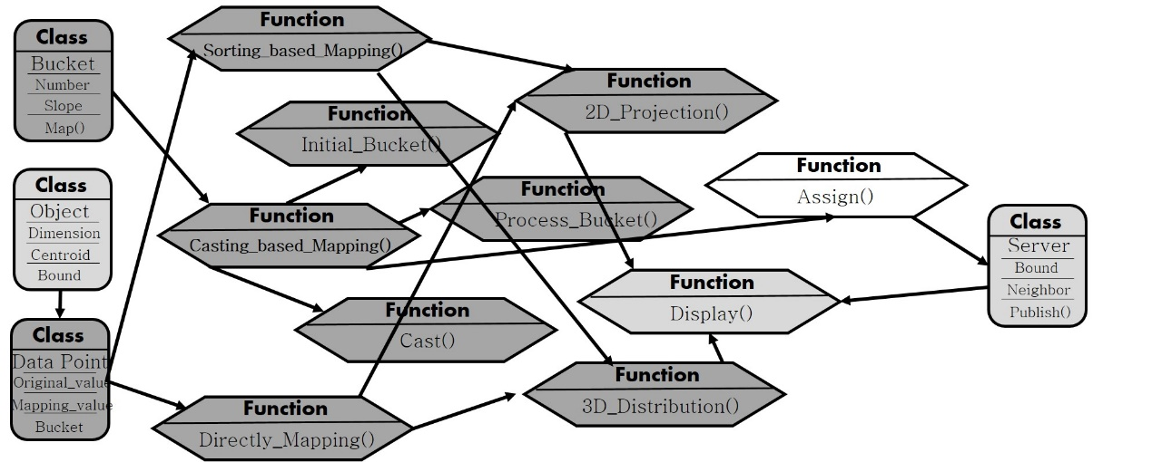
Experiment Design
Mid-term Experimental Design (in the respective of codes)

Slide 17

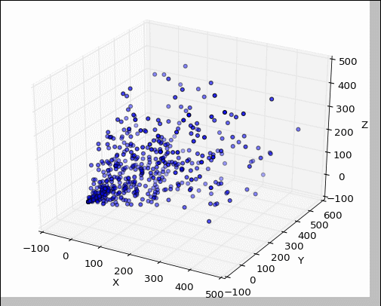
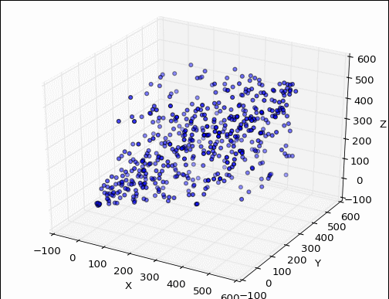
Experiment Result
(If you’d like to watch the dynamic and three-dimensional effect, please enter the slide-playing mode ☺)
Experiment Result: Original & Casting-Based Mapping

Slide 18
Experiment Result
(If you’d like to watch the dynamic and three-dimensional effect, please enter the slide-playing mode ☺)
Experiment Result: Sorting-Based Mapping & Casting-Based Mapping

Slide 19
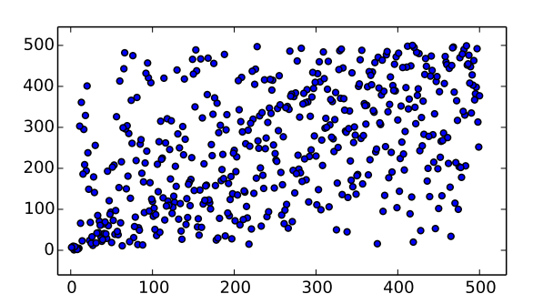
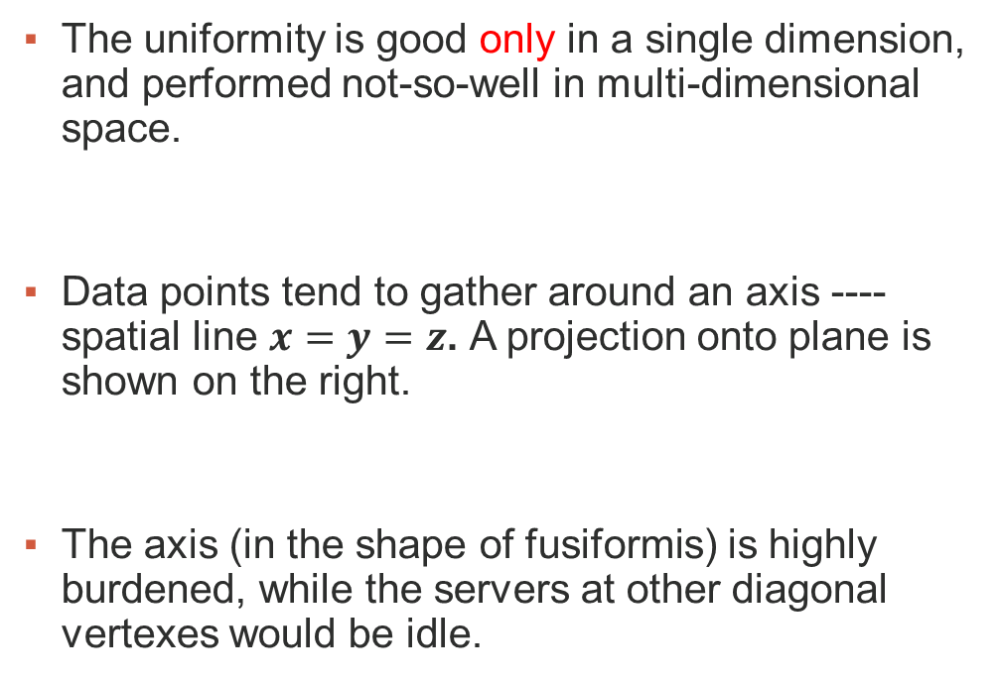
Obvious Problem
The uniformity is good only in a single dimension, and performed not-so-well in multi-dimensional space.
Data points tend to gather around an axis ---- spatial line $x=y=z$. A projection onto plane is shown on the right.
The axis (in the shape of fusiformis) is highly burdened, while the servers at other diagonal vertexes would be idle.

Slide 20
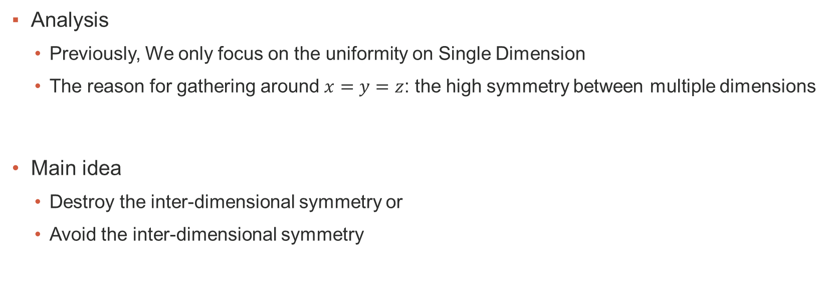
Improvement: Modified Casting-Based Method
Analysis
Previously, We only focus on the uniformity on Single Dimension
The reason for gathering around $x=y=z$: the high symmetry between multiple dimensions
Main idea
Destroy the inter-dimensional symmetry or
Avoid the inter-dimensional symmetry

Slide 21
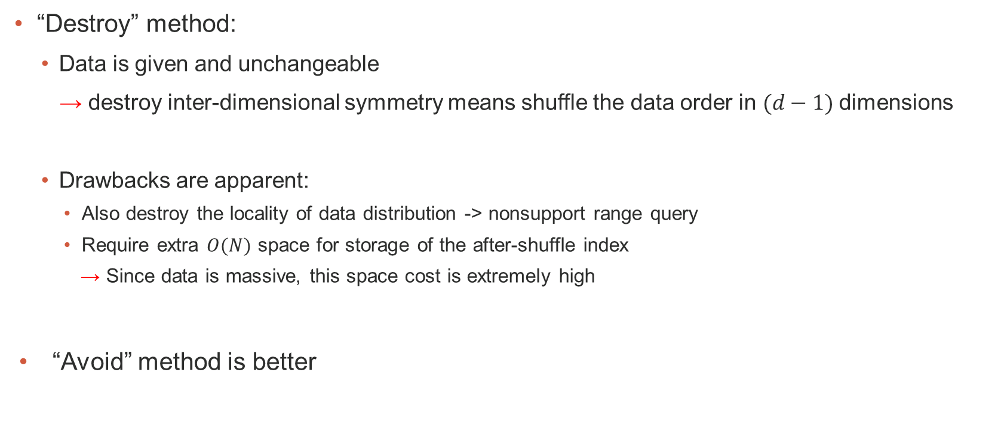
Improvement: Modified Casting-Based Method
“Destroy” method:
Data is given and unchangeable
→ destroy inter-dimensional symmetry means shuffle the data order in $(d−1)$dimensions
Drawbacks are apparent:
Also destroy the locality of data distribution -> nonsupport range query
Require extra $O(N)$ space for storage of the after-shuffle index
→ Since data is massive, this space cost is extremely high
“Avoid” method is better

Slide 22
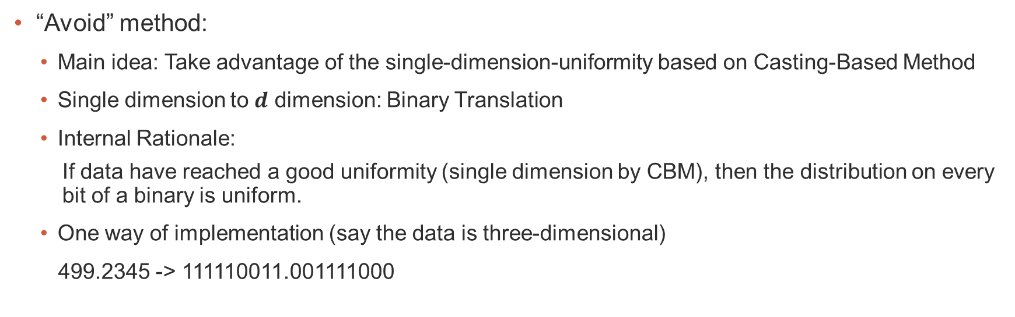
Improvement: Modified Casting-Based Method
“Avoid” method:
Main idea: Take advantage of the single-dimension-uniformity based on Casting-Based Method
Single dimension to $d$ dimension: Binary Translation
Internal Rationale:
If data have reached a good uniformity (single dimension by CBM), then the distribution on every bit of a binary is uniform.
One way of implementation (say the data is three-dimensional)
499.2345 -> 111110011.001111000
111110011.001111000
(110.010, 111.010, 101.110) * Scale
(400, 464, 368)
110.010
111.010
101.110

Slide 23
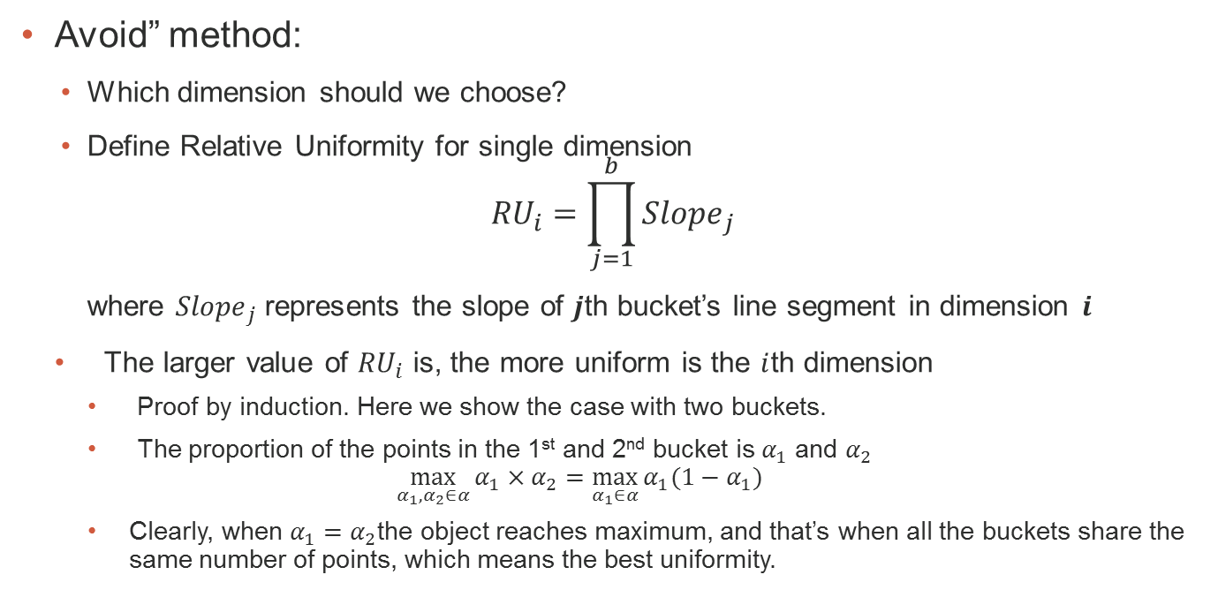
Improvement: Modified Casting-Based Method
Avoid” method:
Which dimension should we choose?
Define Relative Uniformity for single dimension
$${RU}_{i}=\prod_{j=1}^{b}{{Slope}_{j}}$$
where ${Slope}_{j}$represents the slope of $j$th bucket’s line segment in dimension $i$
The larger value of ${RU}_{i}$ is, the more uniform is the $i$th dimension
Proof by induction. Here we show the case with two buckets.
The proportion of the points in the 1st and 2nd bucket is $α_{1}$ and $α_{2}$
$$\max_{α_{1},α_{2}∈α}{α_{1}×α_{2}}=\max_{α_{1}∈α}{α_{1}(1−α_{1})}$$
Clearly, when $α_{1}=α_{2}$the object reaches maximum, and that’s when all the buckets share the same number of points, which means the best uniformity.

Slide 24
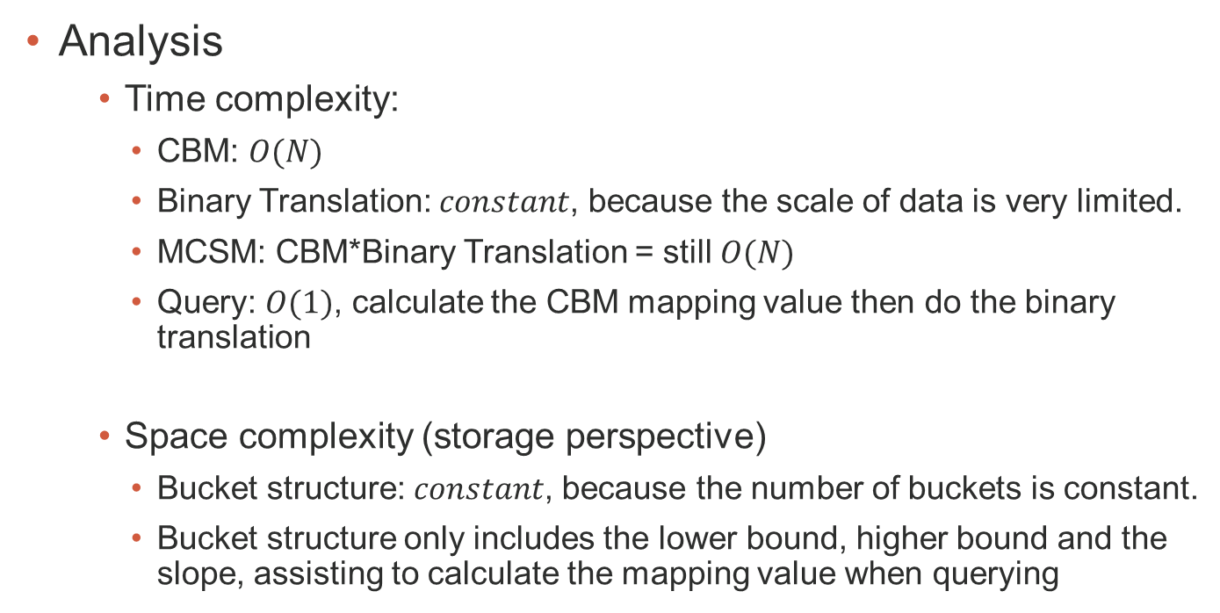
Improvement: Modified Casting-Based Method
Analysis
Time complexity:
CBM: $O(N)$
Binary Translation: $constant$, because the scale of data is very limited.
MCSM: CBM*Binary Translation = still $O(N)$
Query: $O(1)$, calculate the CBM mapping value then do the binary translation
Space complexity (storage perspective)
Bucket structure: $constant$, because the number of buckets is constant.
Bucket structure only includes the lower bound, higher bound and the slope, assisting to calculate the mapping value when querying

Slide 25
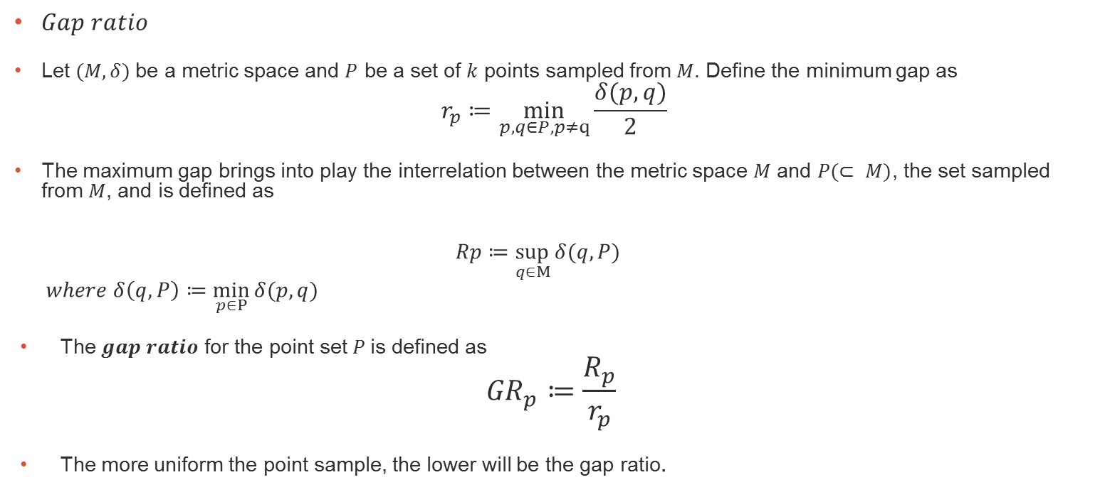
Evaluation Metrics: measures for spatial uniformity
$Gap ratio$
Let $(M, δ)$be a metric space and $P$ be a set of $k$ points sampled from $M$. Define the minimum gap as
$$r_{p}≔\min_{p, q∈P,p≠q}{\frac{δ(p,q)}{2}}$$
The maximum gap brings into play the interrelation between the metric space $M$ and $P(⊂ M)$, the set sampled from $M$, and is defined as
$$Rp≔\sup_{q∈M}{δ(q,P)}$$
$$where δ\left(q,P\right)≔\min_{p∈P}{δ(p,q)}$$
The $gap ratio$ for the point set $P$is defined as
$${GR}_{p}≔\frac{R_{p}}{r_{p}}$$
The more uniform the point sample, the lower will be the gap ratio.

Slide 26
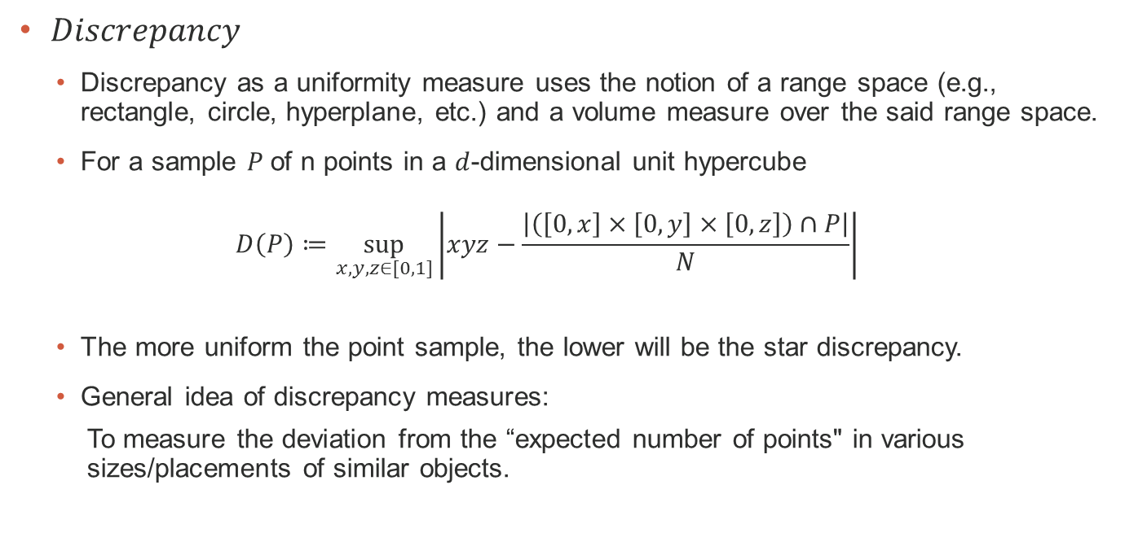
Evaluation Metrics: measures for spatial uniformity
$Discrepancy$
Discrepancy as a uniformity measure uses the notion of a range space (e.g., rectangle, circle, hyperplane, etc.) and a volume measure over the said range space.
For a sample $P$of n points in a $d$-dimensional unit hypercube
$$D\left(P\right)≔\sup_{x,y,z∈[0,1]}\left|xyz−\frac{\left|\left(\left[0,x\right]×\left[0,y\right]×\left[0,z\right]\right)∩P\right|}{N}\right|$$
The more uniform the point sample, the lower will be the star discrepancy.
General idea of discrepancy measures:
To measure the deviation from the “expected number of points" in various sizes/placements of similar objects.

Slide 27
Experiment Results
√

Slide 28
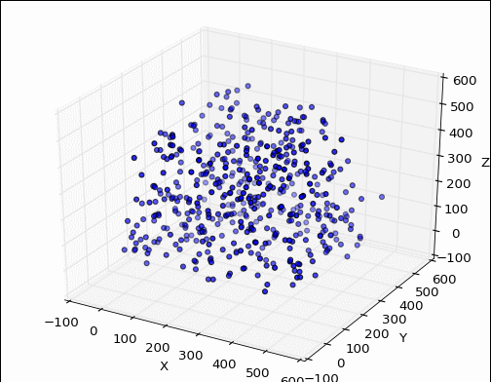
Experiment Results
(If you’d like to watch the dynamic and three-dimensional effect, please enter the slide-playing mode ☺)
Data Set in Overlapping Uniform Distributions
- Casting-Based Method (CBM)
- Modified Casting-Based Method (MCBM)

Slide 29
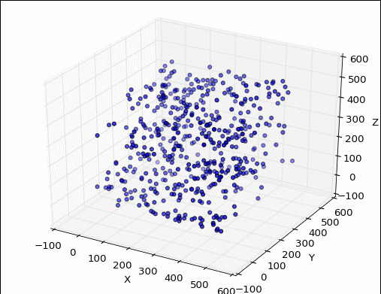
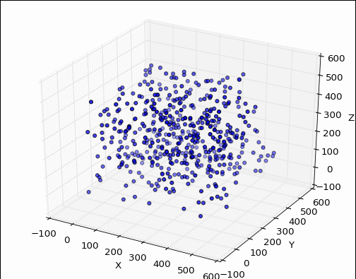
Experiment Results
(If you’d like to watch the dynamic and three-dimensional effect, please enter the slide-playing mode ☺)
Data Set in Combination of Overlapping Uniform Distributions and Normal distribution
- Casting-Based Method (CBM)
- Modified Casting-Based Method (MCBM)
* Result of CBM has an apparent gathering plane of $y=z$

Slide 30
Thank you

